Slide 1
CASE STUDY:
POKETEAM ACADEMY
By: Venus Teah
A fun interactive experience meant for young users

Slide 2

USER STORIES AND BUSINESS USE CASE
I envisioned this project to be an interactive website where fans of the Pokemon franchise would have an additional outlet they can use to explore their love of these little creature.
The website would emulate a fictional school, where Users are enrolled as “Pokemon Trainers”.
They would be able to create an account, choose a “Team” where they can connect with other Users, and have their own Pokemon.

Slide 3
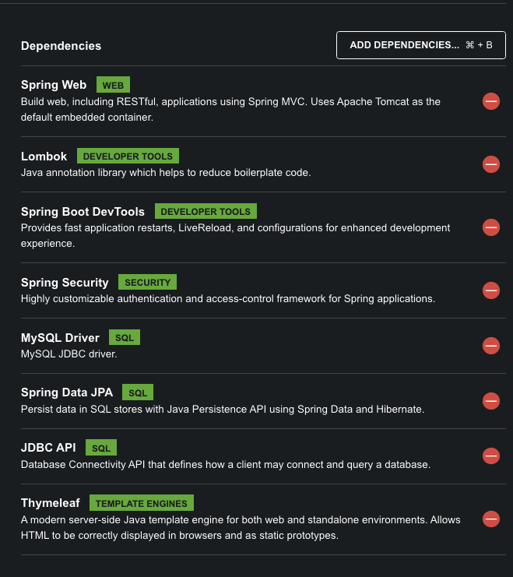



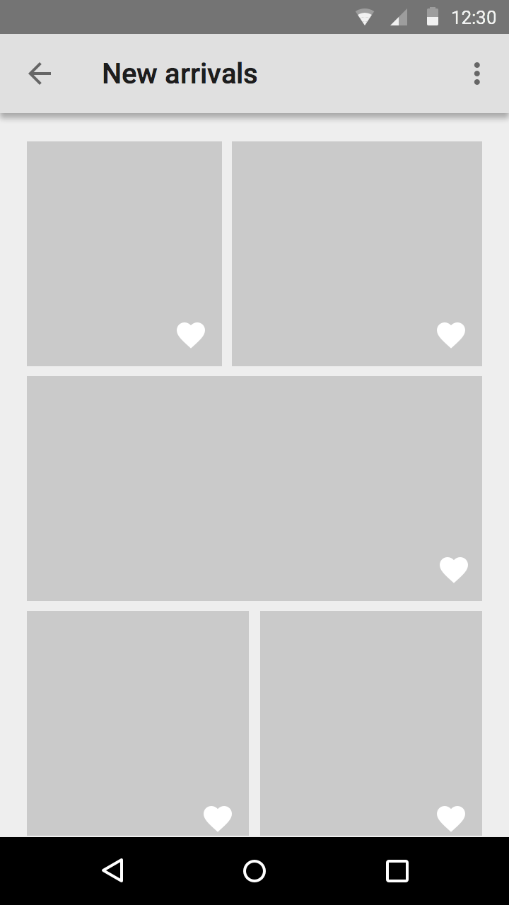
TECHNOLOGIES USED
JAVA
SPRING INITIALIZER
MYSQL/WORKBENCH
SPRING BOOT
SPRING DATA JPA
MAVEN
SPRING SECURITY
THYMELEAF
DRAW.IO
CSS
JS

Slide 4
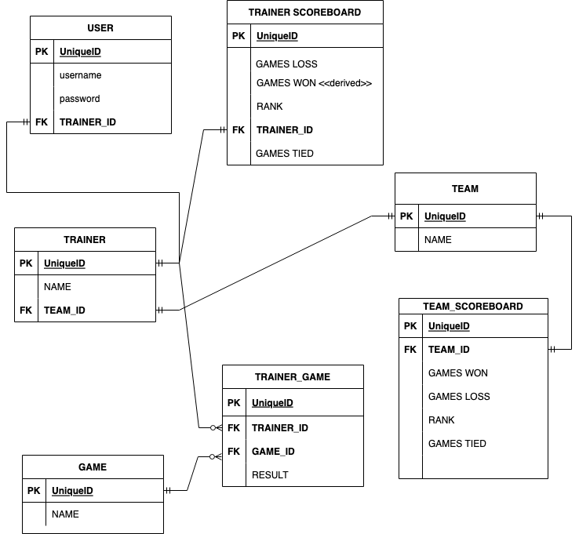

ORIGINAL
ERD
Some Changes:
Adding Role Table For Spring Security
Leaving off game focused entities because of time constraints

Slide 5

Interesting Features
I challenged myself to attempt to extract data from an external api to use in my web app.
Poke API

Slide 6

CHALLENGES
SPRING SECURITY
Learned to take a step back to do additional research even when under pressure
FRONT END
More problems than backend
In hindsight it would have been best to work on the front end first, in order to achieve better time management

Slide 7

Future
Features
Implementing the other entities in my original ERD –
Simple Pokemon Based Games
ScoreBoard
Rankings
Add “Social” features
Chats

Slide 8
Resources
Front end
https://getbootstrap.com/docs/5.0/examples/
https://fontawesome.com/search?q=trash&o=r
https://getbootstrap.com/docs/4.0/examples/grid/
https://mdbootstrap.com/freebies/three-columns/
Springs Security
https://www.youtube.com/watch?v=R76S0tfv36w&t=1970s
https://www.youtube.com/watch?v=L9oWG6aj_U8&t=5s
https://javatechonline.com/spring-security-userdetailsservice-using-spring-boot-3/
https://www.javacodegeeks.com/2018/02/securitycontext-securitycontextholder-spring-security.html

